Slide 1
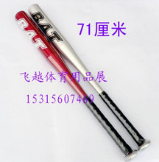

2010 PROBLEM A
The Sweet Spot

Slide 2
问题A：最佳力度点(sweet spot)
解释棒球棒上的“最佳力度点(sweet spot)”
每一名棒球手都知道在棒球棒击球端存在一个击球点，该点在击球的时候能传递最大的力量。为什么该点不位于末端呢？力偶（扭矩）分析似乎更认同末端为“最佳力度点”。但是根据实际经验却并非如此。建立一个数学模式来解释这一实际现象。
一些棒球手认为通过对棒球棒的“木塞法”(corking)处理（即在棒球棒的前端挖出一个圆筒，并且用木塞或者橡胶填充此圆筒，最后用木制盖子扣上）能够提升“最佳力度点”的击球效果。对你已经建立的数模进行拓展来验证或驳斥提升效果这一说法。这是否能够作为美国职棒大联盟禁止“木塞法”的理由？
棒球棒的材质是否重要？也就是说，该模式能够预测不同材质的棒球棒（如水曲柳或者铝制）对击打效果的影响？这是否成为美国职棒大联盟禁止金属棒球棒的理由？

Slide 3
Problem A: The Sweet Spot
Explain the “sweet spot” on a baseball bat. Every hitter knows that there is
a spot on the fat part of a baseball bat where maximum power is transferred to the ball when hit. Why isn’t this spot at the end of the bat? A simple explanation based on torque might seem to identify the end of the bat as the sweet spot, but this is known to be empirically incorrect. Develop a model that helps explain this empirical finding.
Some players believe that “corking” a bat (hollowing out a cylinder in the
head of the bat and filling it with cork or rubber, then replacing a wood cap)
enhances the “sweet spot” effect. Augment your model to confirm or deny this effect.
Does this explain why Major League Baseball prohibits “corking”?
Does the material out of which the bat is constructed matter? That is, does
this model predict different behavior for wood (usually ash) or metal (usually
aluminum) bats? Is this why Major League Baseball prohibits metal bats?

Slide 4
“The Sweet Spot,” asked
teams to explain why the spot on a
baseball bat where maximum power is transferred to the ball is not at the
end of the bat and to determine whether “corking” a bat (hollowing it out
and replacing the hardwood with cork) enhances the “sweet spot” effect.

Slide 5


Slide 6
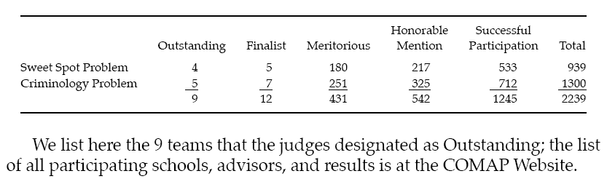
The Results
The solution papers were coded at COMAP headquarters so that names
and affiliations of the authors would be unknown to the judges. Each paper
was then read preliminarily by two “triage” judges at either Appalachian State University (Sweet Spot Problem) or at the National Security Agency (Criminology Problem). At the triage stage, the summary and overall organization are the basis for judging a paper. If the judges’ scores diverged for a paper, the judges conferred; if they still did not agree, a third judge evaluated the paper.
AdditionalRegionalJudgingsiteswerecreatedattheU.S.MilitaryAcademy
and at the Naval Postgraduate School to support the growing number of contest submissions.Final judging took place at the Naval Postgraduate School, Monterey, CA.The judges classified the papers as follows:

Slide 7
The Sweet Spot: AWave Model of
Baseball Bats
We determine the sweet spot on a baseball bat. We capture the essential physics of the ball–bat impact by taking the ball to be a lossy spring and the bat to be an Euler-Bernoulli beam.
To impart some intuition about the model,we begin by presenting a rigid-body model. Next, we use our full model to reconcile various correct and incorrect claims about the sweet spot found in the literature. Finally, we discuss the sweet spot and the performances of corked and aluminum bats, with a particular emphasis on hoop modes.

Slide 8
Introduction
Although a hitter might expect a model of the bat–baseball collision to yield insight into how the bat breaks, how the bat imparts spin on the ball,how best to swing the bat, and so on, we model only the sweet spot.
There are at least two notions of where the sweet spot should be—an impact location on the bat that either
• minimizes the discomfort to the hands, or
• maximizes the outgoing velocity of the ball.
We focus exclusively on the second definition. The velocity of the ball leaving the bat is determined by
• the initial velocity and rotation of the ball,
• the initial velocity and rotation of the bat,
• the relative position and orientation of the bat and ball, and
• the force over time that the hitter’s hands applies on the handle.

Slide 9
We assume that the ball is not rotating and that its velocity at impact is perpendicular to the length of the bat.
We assume that everything occurs in a single plane, and we will argue that the hands’ interaction is negligible.
In the frame of reference of the center of mass of the bat, the initial conditions are completely specified by
• the angular velocity of the bat,
• the velocity of the ball, and
• the position of impact along the bat

Slide 10
Our paper is organized as follows.
First, we present the Brody rigidbodymodel, illuminating the recoil effects of impact.
Next we present a full computational model based on wave propagation in an Euler-Bernoulli beam coupled with the ball modeled as a lossy spring.
We compare this model with others and explore the local nature of impact, the interaction of recoil and vibrations, and robustness to parameter changes.
We adjust the parameters of the model to comment on the sweet spots of corked bats and aluminum bats.
Finally, we investigate the effect of hoop frequencies
on aluminum bats.

Slide 11
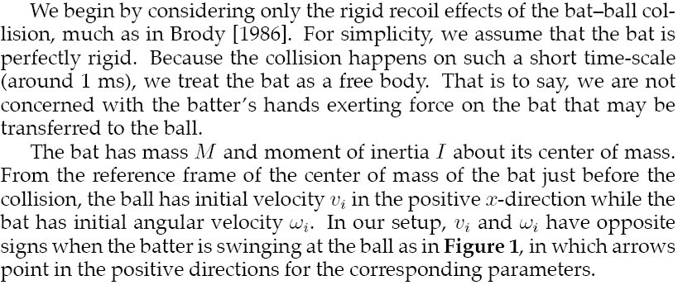
A Simple Example

Slide 12
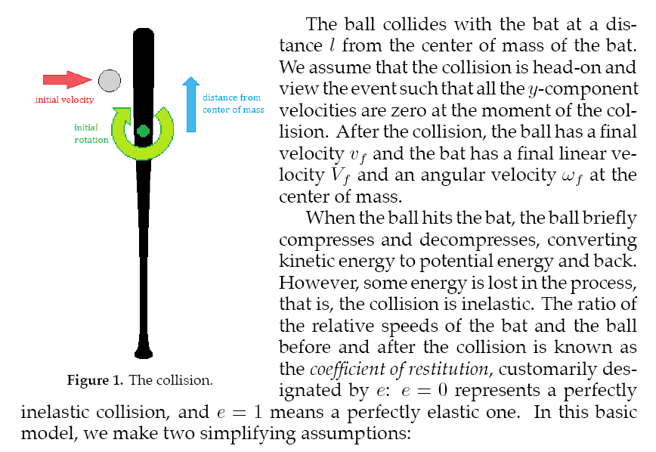

Slide 13
Initial states
BAT Linear velocity, Angular velocity
BALL Velocity
The Final States
BAT Linear velocity, Angular velocity
BALL Velocity
Restitution e
e = 0 represents a perfectly inelastic collision,
e = 1 means a perfectly elastic one.
The coefficient of restitution of an object is a fractional value representing the ratio of velocities after and before an impact. An object with a COR of 1 collides elastically, while an object with a COR < 1 collides inelastically. For a COR = 0, the object effectively "stops" at the surface with which it collides, not bouncing at all

Slide 14
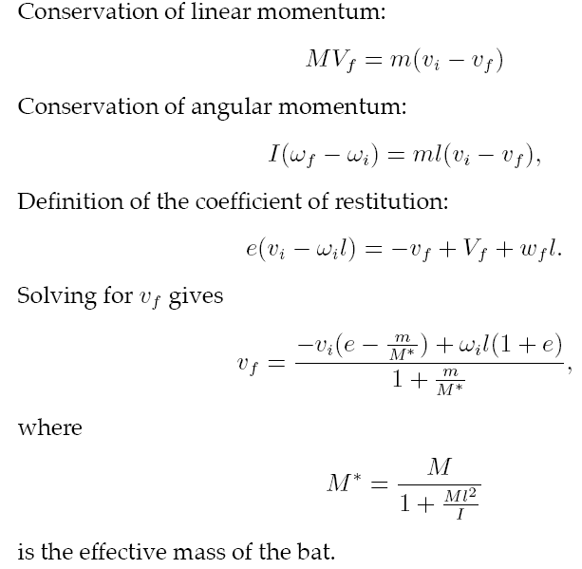

Slide 15
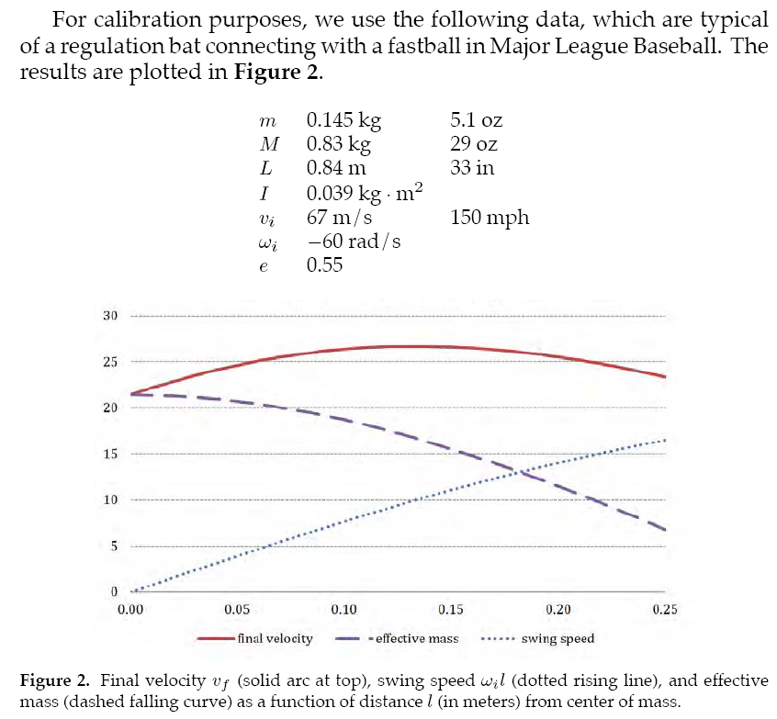

Slide 16
Assumptions contradict each other
• We treated the bat as a free body because the collision time was so short.In essence, during the 1 ms of the collision, the ball “sees” only the local geometry of the bat, not the batter’s hands on the handle. On the other hand, we assumed that the bat was perfectly rigid—but that means that the ball “sees” the entire bat.
• We also assumed that e is constant along the length of the bat and for different collision velocities. Experimental evidence [Adair 1994] suggests that neither issue can be ignored for an accurate prediction of the location of the sweet spot. We need a more sophisticated model

Slide 17
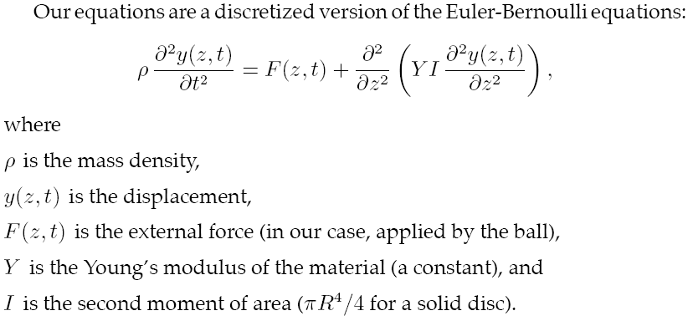
Mathematics of Our Model

Slide 18
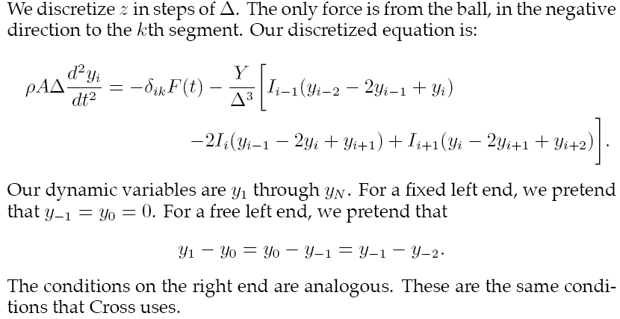

Slide 19
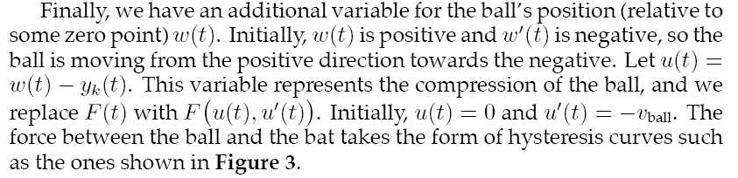
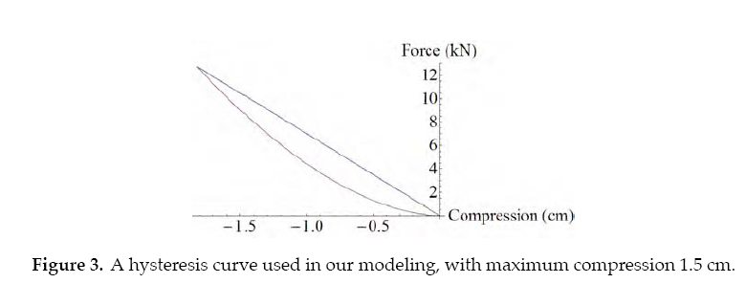

Slide 20
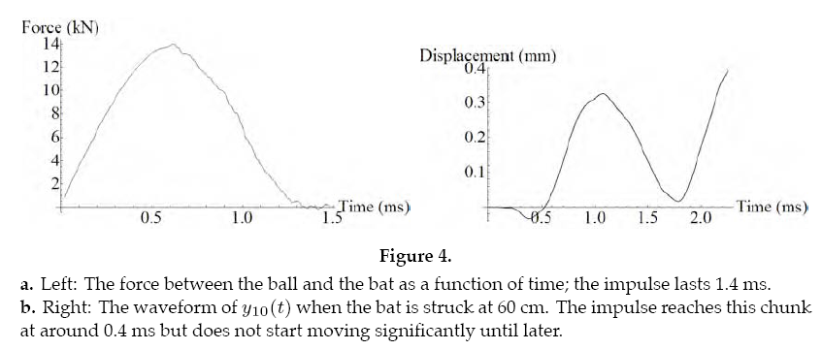
Simulation and Analysis
Our model’s two main features are
wave propagation in the bat
nonlinear compression/decompression of the ball.
The latter is illustrated by the asymmetry in Figure 4a.

Slide 21
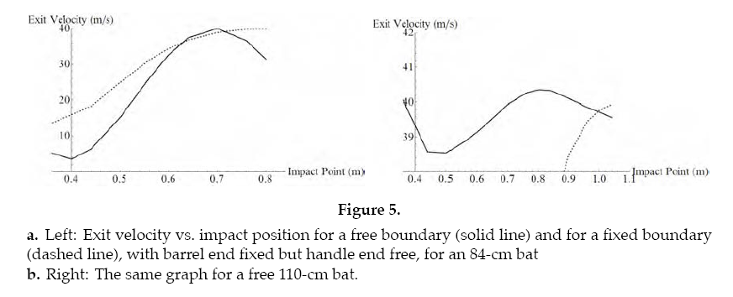
In Figure 5a, show the effects of Cross’s model.
For fixed- ands free-boundary conditions

Slide 22
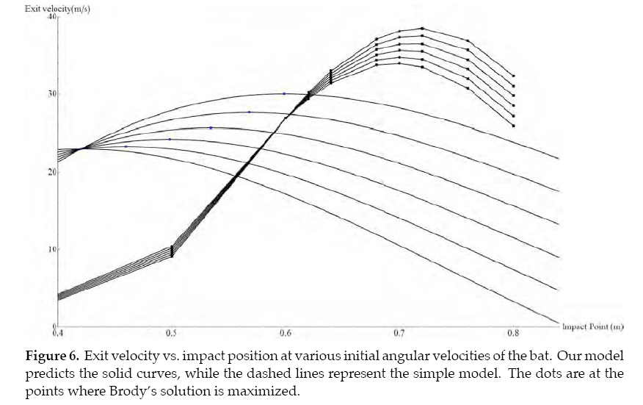
In Figure 6, we present the results of changing the angular velocity.

Slide 23
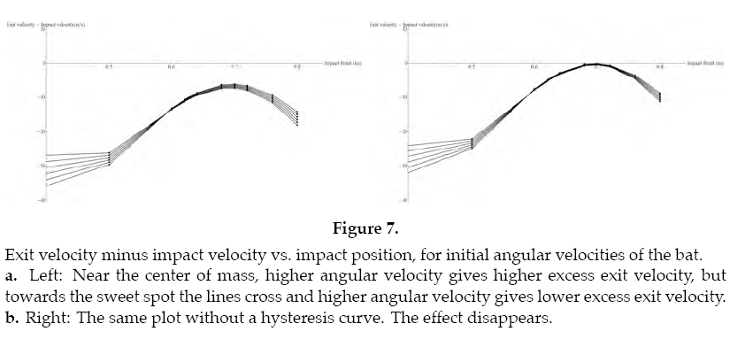
In Figure 7a, we show that near the sweet spot (at 0.7 m), increasing angular velocity actually decreases the excess exit velocity .

Slide 24
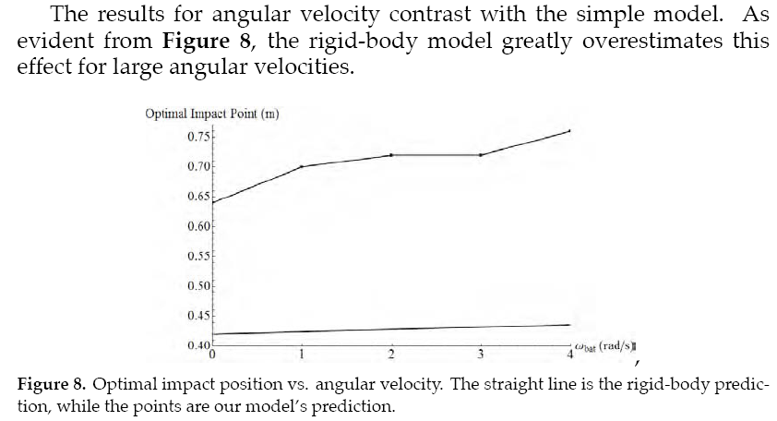

Slide 25
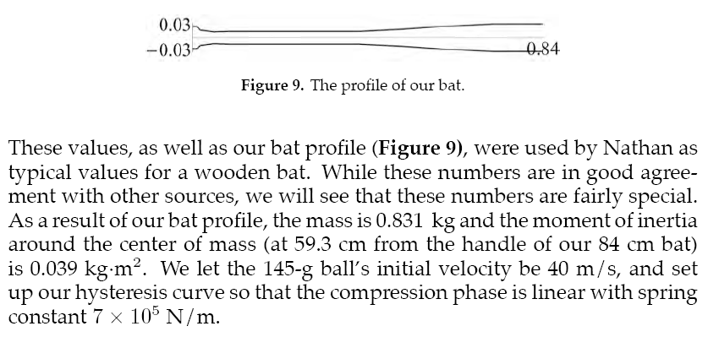
Parameter Space Study

Slide 26
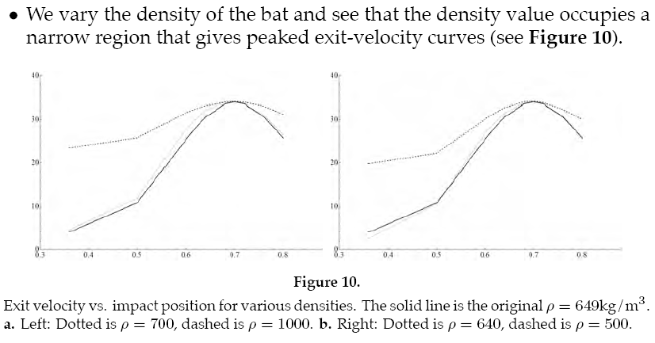

Slide 27
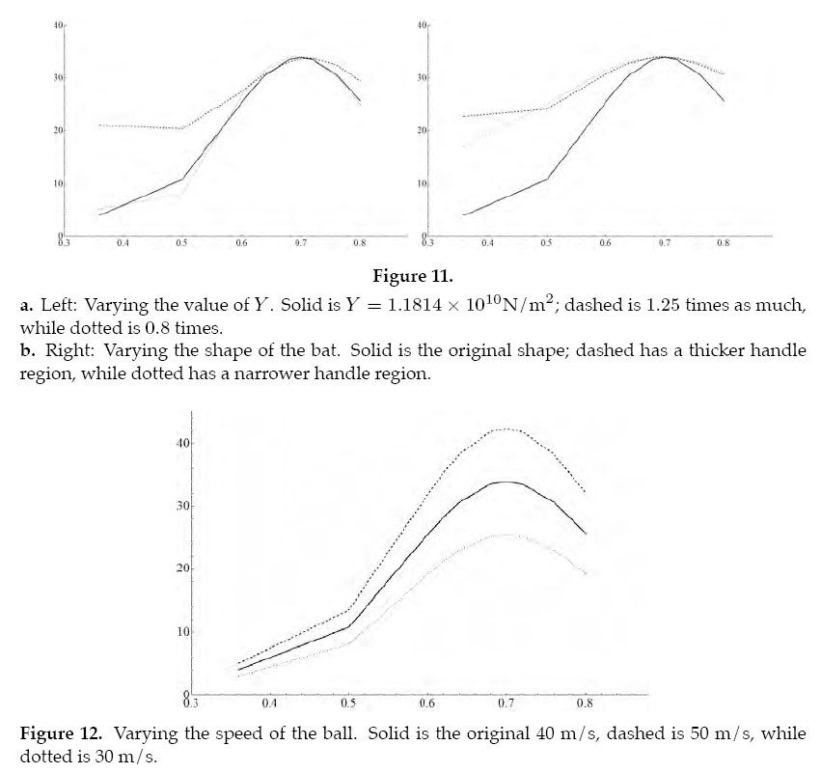
Alternatives to Wooden Bats

Slide 28
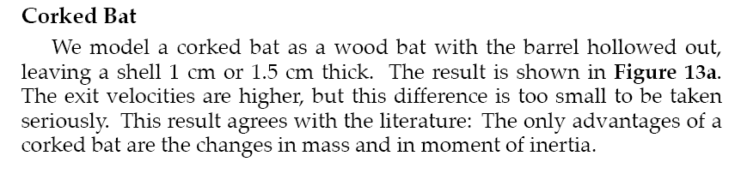
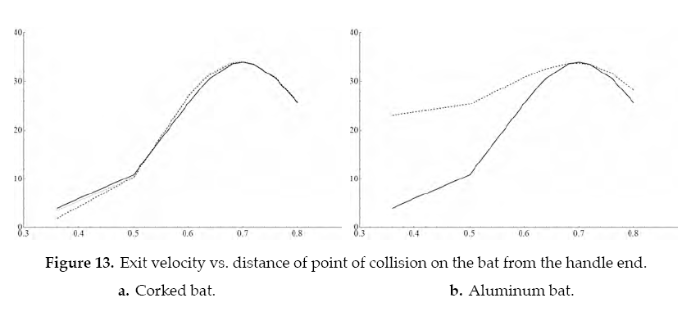

Slide 29
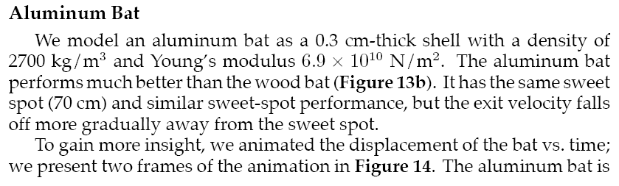
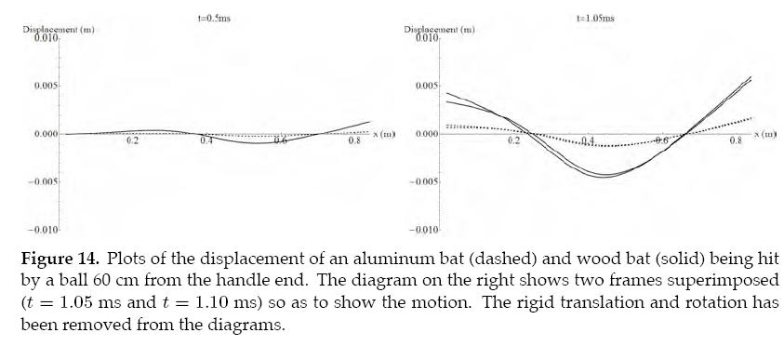

Slide 30
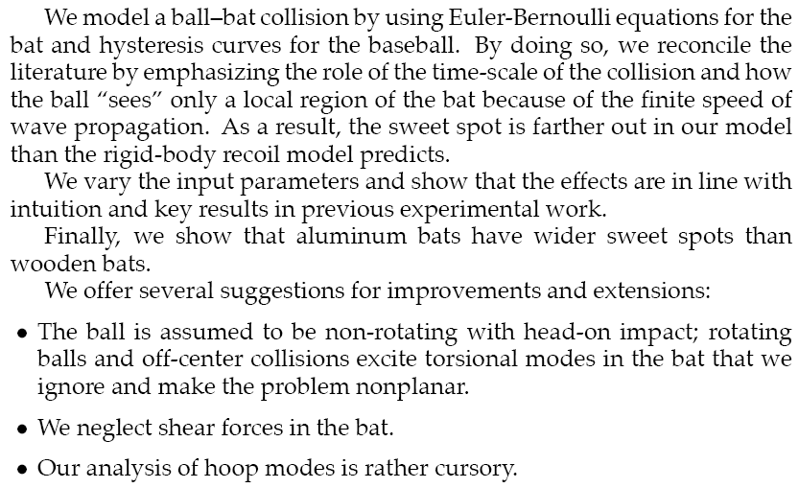
Conclusion

Slide 31

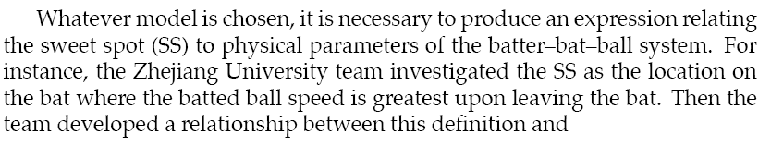

Slide 32
